Slide 1
TEXT & TEXT COMPRESSION
Dr. Quang Duc Tran

Slide 2
Various Types of Text
Unformatted text (i.e., plain text) enables pages to be created, which consist of strings of fixed-sized characters from a limited character set
Formatted Text (i.e., rich text (RTF)) enables pages to be created, which consist of strings of characters of different styles, sizes and shape with tables, graphics, and images inserted at appropriate points
Hypertext enables an integrated set of documents (Each consisting of a formatted text) to be created, which have defined linkages between them

Slide 3
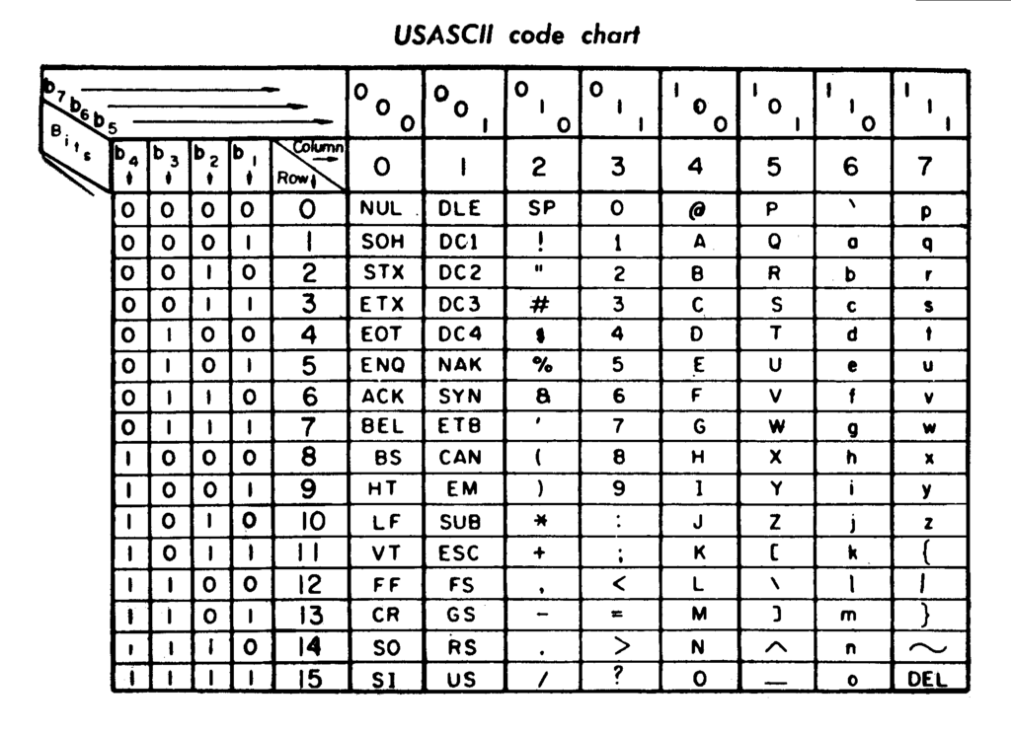
ASCII Character Coding
The American Standard Code for Information Interchange is one of the most widely used character sets. Each character is represented by a 7-bit codeword.
33 control characters
Back space, Delete, Escape
95 printable characters
Alphabetic, Numeric, Punctuation
A – 1000001 (65)

Slide 4
ISO/IEC 8859
ISO/IEC 8859 is a standard for 8-bit character encodings. It allows positions for another 96 printable characters (Latin alphabets)
ISO/IEC 8859 is divided into the following parts:
Part 1: Latin-1 Western European
Part 2: Latin-2 Central European
...
Part 16: Latin-10 South-Eastern European
Although Vietnamese uses Latin based characters, it does not fit into 96 positions.

Slide 5
Unicode
Two mapping methods
Unicode Transformation Format (UTF)
UTF-8: 8 bit, variable-width length which maximizes compatibility with ASCII
UTF-16: 16 bit, variable-width length
UTF-32: 32 bit, fixed-width length
Universal Character Set (UCS)
UCS-2 is a subset of UTF-16 (ISO 10646): a character is represented by a fixed-length 16 bits (2 byte). It is used on many GSM networks when a message cannot be encoded using GSM-7. SMS message is transmitted in 140 octets, a message using UCS-2 has a maximum of 70 characters.
UCS-4 and UTF-32 are functionally equivalent

Slide 6
Unicode (Cont.)
UTF-8 is the dominant encoding on the World Wide Web (used in over 94% of websites), uses one byte for the first 128 code points and up to 4 bytes for other characters. The first 128 Unicode code points represent the ASCII characters.
UTF-16 is used internally by systems, such as Microsoft Windows (Windows CE/2000/XP/2003/Vista/7/10), Java programming language and JavaScript.

Slide 7
Text Compression
Lossless compression
Statistical compression (e.g., Huffman coding)
Compression using dictionary (e.g., Lempel-Ziv)
These are intended for compressing natural language text and other data with a similar sequential structure.
These are used by general purpose compressors such as zip, bzip2, 7zip, etc.
Compression rate: approximately ½-2/3 document size

Slide 8
Huffman Coding
Huffman coding: A statistical compression technique, which was developed by David A. Huffman in 1952. Huffman coding is not always optimal among all compression methods. It is replaced with arithmetic coding if better compression ratio is required.
Huffman coding is in wide use because of its simplicity, high speed. It is often used as a “back-end” to other compression methods. DEFLATE (PKZIP algorithm) and multimedia codes, such as JPEG and MP3 have a quantization followed by the use of Huffman coding.

Slide 9
The Basic Algorithm
Not all characters occur with the same frequency.
Not all characters are allocated the same amount of space.
Codeword lengths are no longer fixed like ASCII.
Codeword lengths vary and will be shorter for the more frequently used characters.

Slide 10
The Basic Algorithm (Cont.)
Scan text to be compressed and tally occurrence of all characters.
Sort or prioritize characters based on number of occurrences in text.
Build Huffman code tree based on prioritized list.
Perform a traversal of tree to determine all codewords.
Scan text again and create new file using the Huffman codes.

Slide 11
Examples
Consider the following text:
BCAACADBDCADAEEEABACDBACADCBADABEABEAAA

Slide 12
Examples
Consider the following text:
BCAACADBDCADAEEEABACDBACADCBADABEABEAAA
A: 15; B: 7; C: 6; D: 6; E: 5
(39)
0
1
A(15)
(24)
0
1
(13)
(11)
0
1
0
1
B(7)
C(6)
D(6)
E(5)

Slide 13
Huffman Coding: Q&A
Building a Huffman tree for the sequences:
“go go gophers”
“streets are stone stars are not”

Slide 14
Adaptive Huffman Coding
Huffman coding needs a probability distribution as an input. The method for determining the probabilities is called a model, which can be static, adaptive or semi-adaptive.
A static model is a fixed model that is known by both the compressor and decompressor. Compression of the file requires two passes, one pass to find the frequency of each character and construct the Huffman tree, and a second pass to compress the file.
Static model is not always available (e.g., live audio, video). Even when available, it could be heavy overhead

Slide 15
Adaptive Huffman Coding
An adaptive model changes during the compression. It allows building the code as the symbols are being transmitted, having no initial knowledge of source distribution (one-pass encoding)
The benefit of one-pass procedure is that the source can be encoded in real time. However, it becomes more sensitive to transmission error, since just a single loss ruins the whole code.

Slide 16
Huffman Coding Characteristics
It is a lossless data compressing technique generating variable length codes for different symbols
It considers frequency of characters for generating codes
It has complexity of n.log(n) where n is the number of unique characters
The length of the code for a character is inversely proportional to the frequency of its occurrence
No code is prefix of another code

Slide 17
Huffman Coding: Q&A
Which of the following is true about Huffman Coding?
Huffman coding may become lossy in some cases
Huffman coding is not optimal lossless codes in some cases
In Huffman coding, no code is prefix of any other code
All of the above
The character a to h have the set of frequencies as follows: a:1, b:1, c:2, d:3, e:5, f:8, g:13, h:21. A Huffman code is used to represent the characters. What is the sequence of characters corresponding to the 110111100111010?

Slide 18
Huffman Coding: Q&A
A network company uses a compression technique to encode the message before transmitting over the network. Suppose the message contains the following characters with their frequency: a:5, b:9, c:12, d:13, e:16, f:45. Each character in input message takes 1 byte. If the compression technique used is Huffman Coding, how many bit will be saved in the message?
Suppose we have a Huffman tree for an alphabet of n symbols, and that the relative frequencies of the symbols are 1, 2, 4, ..., 2^{n-1}. Sketch the tree for n=5; for n=10. In such a tree (for general n) how may bits are required to encode the most frequent symbol? the least frequent symbol?

Slide 19
Arithmetic Coding
Arithmetic coding is a data compression technique that encodes data (data string) by creating a code string which represents a fractional value on the number line between 0 and 1.
1
0.2
0.08
0.072
0.0688
a₄
a₄
a₄
a₄
a₄
0.06752
a₃
a₃
a₃
a₃
a₃
a₂
a₂
a₂
a₂
a₂
a₁
a₁
a₁
a₁
a₁
0
0
0.04
0.056
0.0624

Slide 20
Arithmetic vs. Huffman
Compression
Huffman is within 1/m of entropy
Arithmetic is within 2/m of entropy
Context
Huffman needs a tree for every context
Arithmetic needs a small table of frequencies for every context
Adaptation
Huffman has an elaborate adaptive algorithm
Arithmetic has a simple adaptive mechanism

Slide 21
Arithmetic Coding: Q&A
Demonstrate how to encode a sequence of five symbols, namely BABAB from the alphabet (A, B), using arithmetic coding algorithm if p(A)=1/5 and p(B)=4/5.
Using the coding in the previous question as an example, explain how the arithmetic decoding algorithm works, for example, how to get the original BABAB back from the compressed result.

Slide 22
Arithmetic Coding: Q&A
Demonstrate how to encode a sequence of four symbols, namely x₁x₂x₂x₃ using arithmetic coding algorithm if p(x₁)=0.5, p(x₂)=0.3 and p(x₃)=0.2. Calculate the data size after compression.
Notes:
The interval for the sequence is (0.361,0.37] 1/4+1/16+1/32+1/64+1/128 = 0.3672 0101111 (7 bit)

Slide 23
Lempel-Ziv Coding
Lempel-Ziv Coding relies on reoccurring patterns to save data space.
Example: Extended ASCII code – Every character is stored with 8 binary bit, allowing up to 256 unique characters for the data.
Lempel-Ziv tries to extend the library to 9 to 12 bits per character. The new symbols are made up of combination of symbols that occurred previously in the string. Lempel-Ziv do not compress well with short, diverse strings.

Slide 24
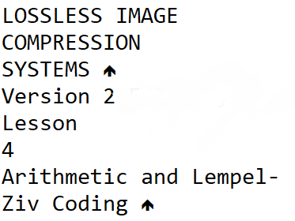
Lempel-Ziv Coding (Cont.)
Type | Bitmap
Colors | 1 to 8 bit
Compression | LZW
Maximum Image Size | 64Kx64K pixels
Multiple Images Per File | Yes
Numerical Format | Little-endian
Platform | MS-DOS, Macintosh, UNIX
LZW Coding has been adopted in a variety of imaging file formats, such as GIF, TIFF and PDF.

Slide 25
Lempel-Ziv Coding (Cont.)
LZW works best for files containing lots of repetitive data. This is often the case with text and monochrome images.
LZW compression is fast, but is a fairly old compression technique. All recent computer systems have the horsepower to use more efficient algorithms.
Some versions of LZW are copyrighted. This has seriously hampered the popularity of LZW.

Slide 26
Examples
Consider the following text: ABCBCABCABCD
Previous Input | Input | Output | Symbol | Index
NIL | A
A | B | A | AB | 256
B | C | B | BC | 257
C | B | C | CB | 258
B | C
BC | A | BC | BCA | 259
A | B
AB | C | AB | ABC | 260
C | A | C | CA | 261
A | B
AB | C
ABC | D | ABC | ABCD | 262
D | EOL | D
Previous Input | Input | Output | Symbol | Index
NIL | A | A
A | B | B | AB | 256
B | C | C | BC | 257
C | 257 | BC | CB | 258
BC | 256 | AB | BCA | 259
AB | C | C | ABC | 260
C | 260 | ABC | CA | 261
ABC | D | D | ABCD | 262

Slide 27
Lempel-Ziv Coding: Q&A
Which of the following statements is not true for LZW coding?
It is a fixed-length coding for variable-length symbol sequence
It does not require a priori knowledge of the source symbol probabilities
Larger file size leads to poorer compression
Decoder dictionary can be derived from the encoded sequence
A LZW dictionary starts with two entries 0 and 1. The dictionary size after parsing the symbol stream 00101100 is
4
5
6
7

Slide 28
Lempel-Ziv Coding: Q&A
A LZW dictionary having maximum size of 32 has 10 entries to start with – the decimal number 0-9.
Encode the digit sequence 8,2,8,2,2,8,2,2,2,8 using LZW coding and determine the compression ratio.
Repeat part (A) for the digit sequence 9,7,2,0,6,1,5,3,4,8.
Why is the compression ratio better in (A) as compared to (B)?

